Slide 1
Loan Analysis & Insights for Risk Identification
By - Sandeep Kumar
Tools Used:
Python | Pandas | NumPy | Seaborn | SQL | Power BI | Excel

Slide 2




End-to-End Data Analysis Workflow
(Excel → Python → SQL → Power BI)
Explore,understand, validate
Clean, transform,
analyse
Store, query, optimise
Visualise, present, deliver insights
Raw Data → Processing & Analysis → Database → Dashboard & Insights

Slide 3
Problem Statement
Banks give loans to many customers, but some customers do not repay, which
causes financial loss.
This project aims to:
Analyze customer and loan-related data
Identify key factors that influence default
Detect high-risk borrower profiles
Provide actionable insights that help minimize losses
Support better credit decision-making using data
Business Impact
Improve approval quality
Reduce risk exposure
Enhance credit policies using data-backed insights

Slide 4
Excel – Initial Data Understanding
Before moving to Python, the dataset was first explored in Excel to perform basic validation and early insights.
1. Data Import & Structure Check
Loaded the raw dataset into Excel
Verified total rows, columns, and header format
Ensured no misaligned or broken columns
2. Basic Data Quality Checks
Used filters to spot blank cells, inconsistent values
Checked for duplicate rows using Remove Duplicates

Slide 5
Excel – Initial Data Understanding
3. Quick Summary Using Excel Tools
Created Pivot Tables to review:
  Loan Status distribution (Good vs Default)
  Loan Purpose counts
  Grade-wise loan distribution
  Loan amount ranges
4. Initial Trend & Pattern Identification
Created quick charts:
  Loan Amount histogram
  Interest Rate distribution
  Loan Purpose bar chart
5. Export for Python
Cleaned file saved as .xlsx / .csv
Handed over to Python for advanced cleaning & EDA

Slide 6
Data Summary
Dataset Overview
The dataset contains information about customers, their loan details, and their repayment status. It helps us understand the factors that influence whether a loan is repaid or defaulted.
Dataset Size
Total Rows: 38576
Total Columns: 24
Key Columns Include
Customer Information: age, income, employment type
Loan Details: loan amount, interest rate, loan term
Financial Indicators: credit score, debt-to-income ratio
Loan Status: Good loan / default

Slide 7
Data Cleaning & Preparation
1. Missing Values Handling
Checked missing values in all columns
The column emp_title had missing values
Filled missing emp_title with "Unknown“
2. Duplicate Records
Verified for duplicated entries
Total duplicate rows: 0
3. Outlier Detection
Identified outliers using boxplots
Outliers were not removed, kept for analysis to avoid data loss
4. Fixing Data Types
Converted date-related columns into proper datetime format:
  issue_date
  last_credit_pull_date
  last_payment_date
  next_payment_date

Slide 8
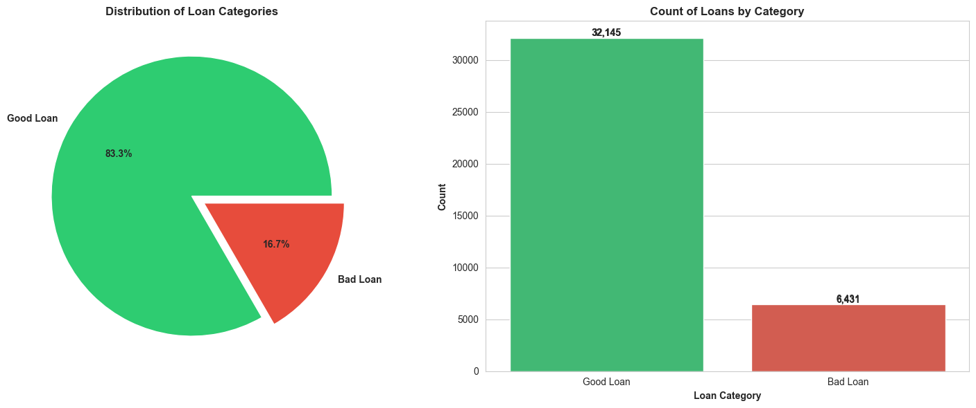
Dependent Variable
📌 loan_status (Good Loan vs Default Loan)
This column tells you whether a borrower repaid the loan or defaulted.

Slide 9
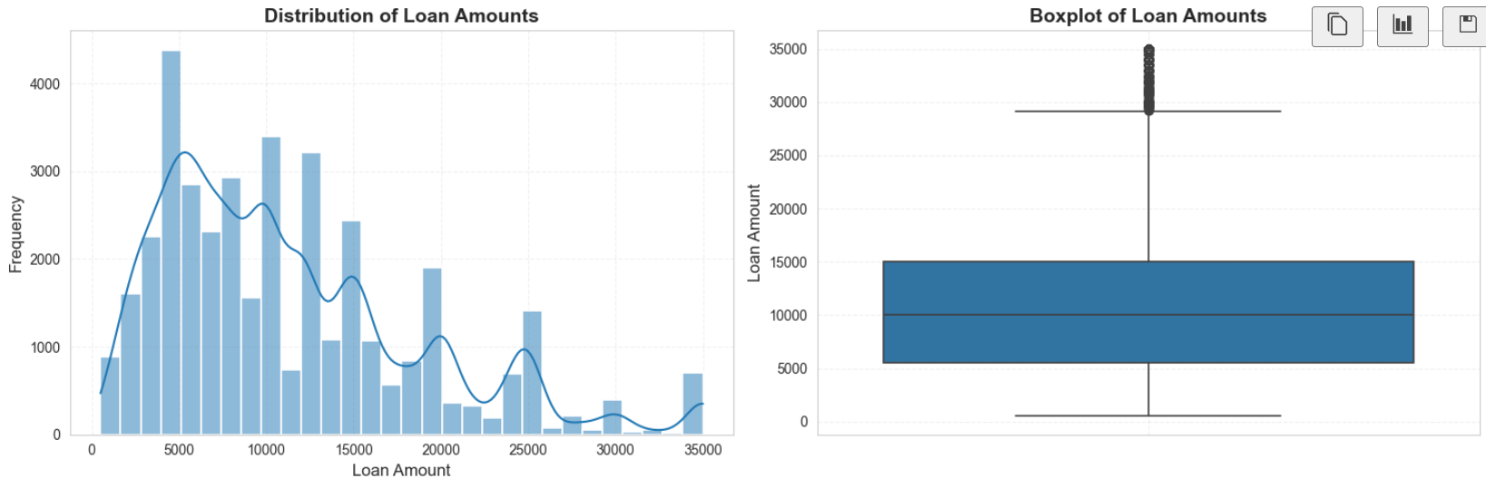
Exploratory Data Analysis (EDA)
Loan Amount
Most loan amounts lie between $5,000 and $15,000.
The distribution is right-skewed, meaning some customers take very high loan amounts.
Boxplot shows clear outliers, but we did not remove them because they represent real high-value loans

Slide 10

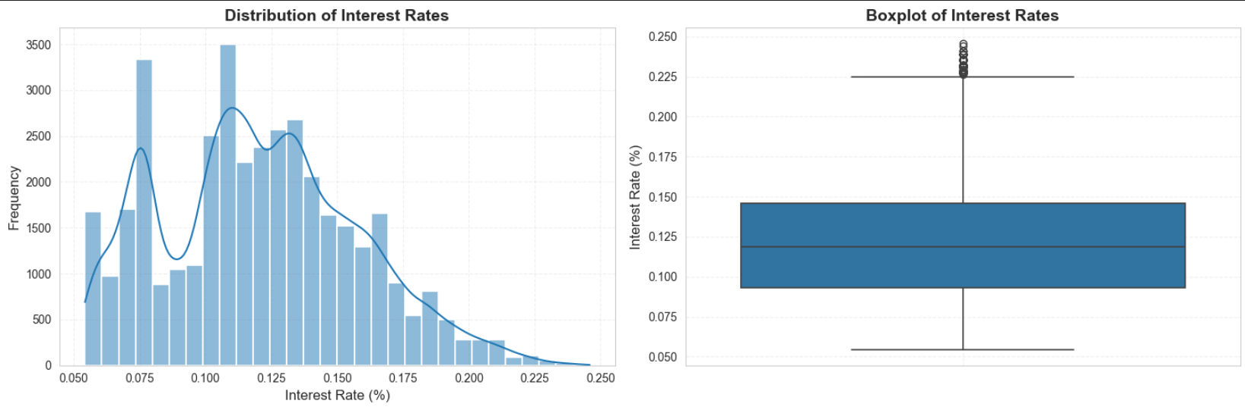
Exploratory Data Analysis (Continued)
Interest rates are mostly between 8% and 14%.
The distribution is slightly right-skewed, with a few customers getting higher interest rates.
Outliers are present at the upper end (18%–24%).
These outliers are expected due to risk-based pricing.

Slide 11
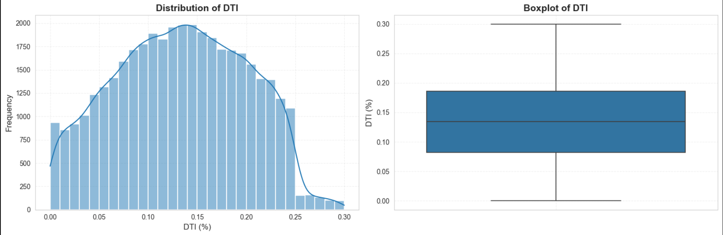
Exploratory Data Analysis (Continued)
Most DTI values lie between 8%–18%.
Distribution is slightly right-skewed.
Median DTI ≈ 13%.
Few high DTI cases, but no major outliers

Slide 12
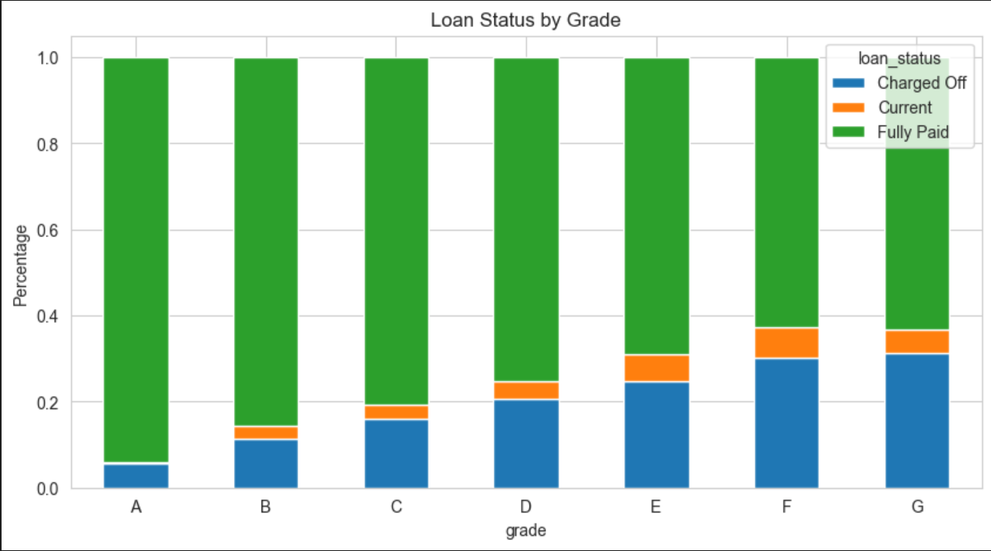
Exploratory Data Analysis (Continued)
Higher grades (A, B, C) have very low Charged-Off rates.
Lower grades (D, E, F, G) show increasing default (Charged-Off) percentages.
Most loans across all grades are Fully Paid, but risk clearly increases as grade decreases.
This confirms that loan grade is strongly linked to credit risk.

Slide 13
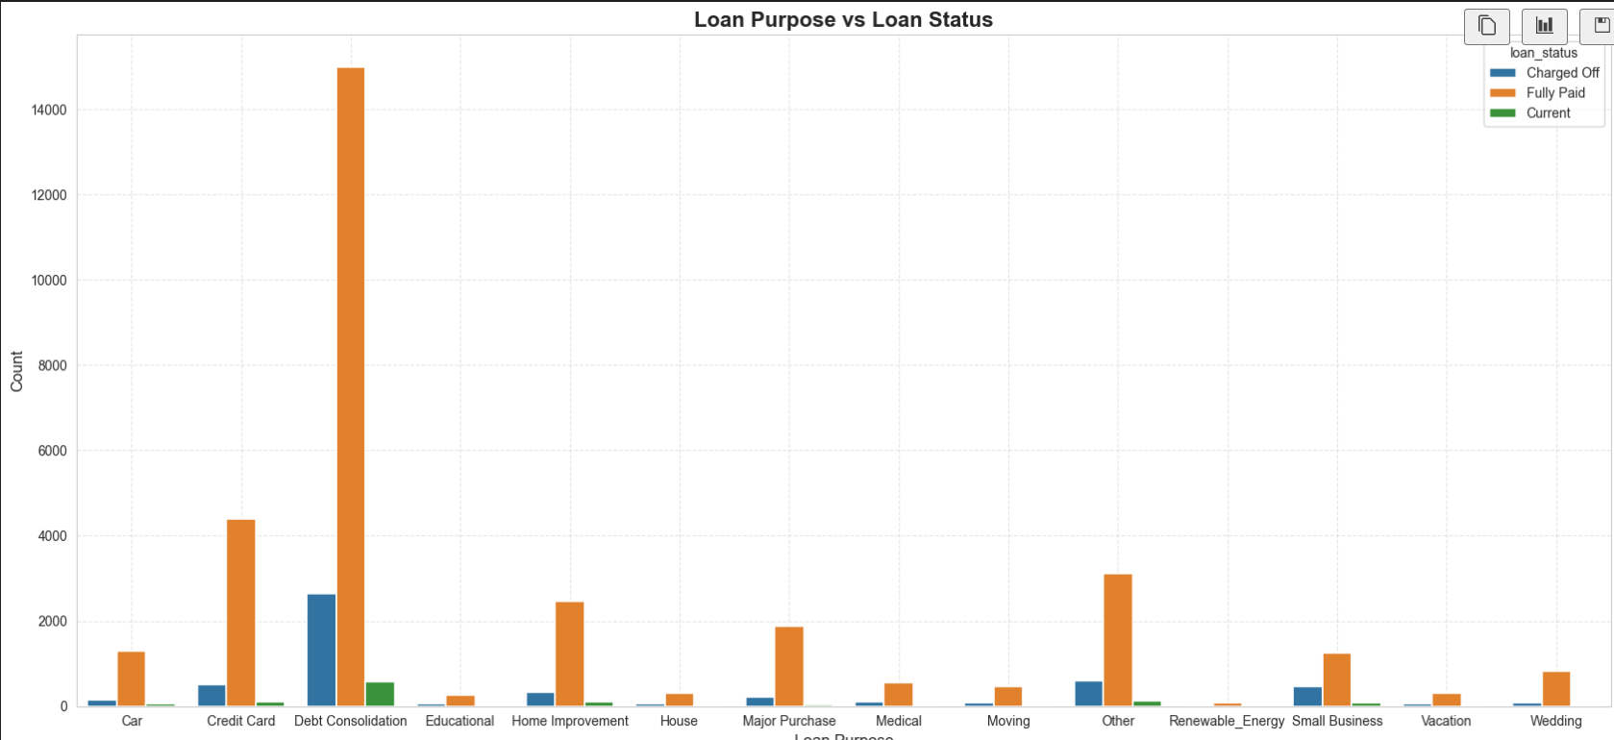
Exploratory Data Analysis (Continued)
Debt Consolidation is the most common loan purpose; it also has a high number of Charged-Off loans.
Credit Card, Home Improvement, and Other categories also show moderate levels of default.
Very few loans across all categories remain in Current status.
Loan purpose can help identify high-risk borrower segments.

Slide 14
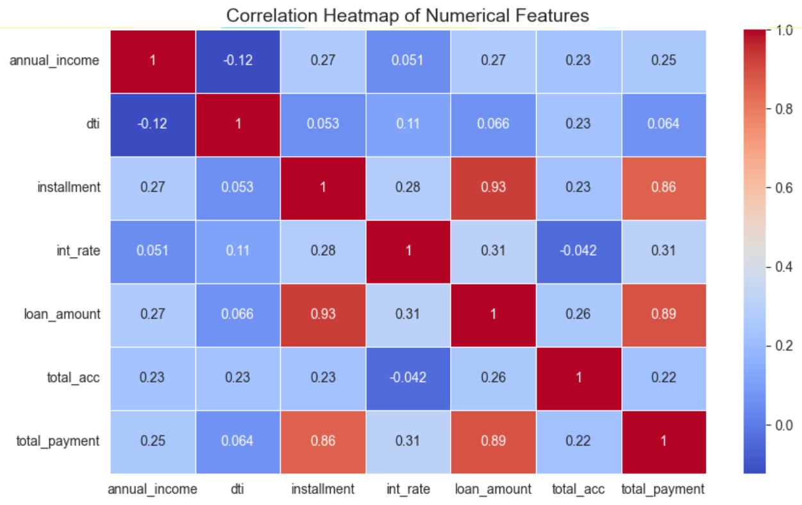
Exploratory Data Analysis (Continued)
Installment and Loan Amount show very high correlation.
Total Payment is strongly correlated with both Loan Amount and Installment.
Annual Income, DTI, and Interest Rate have weak correlations with other features.
No strong multicollinearity issues except the Loan Amount ↔ Installment pair

Slide 15
Key Insights from EDA
Loan Status
Dataset is imbalanced → ~83% Good Loans, ~17% Bad Loans.
Loan Amount
Most loan amounts fall between $5K–$15K.
Higher loan amounts are more common in Current loans.
Borrowers with higher loan amounts are more likely to be Charged Off.
Interest Rate
Charged-off loans have higher interest rates.
Fully Paid loans have lower interest rates.
Higher interest rates increase the chance of default.

Slide 16
Key Insights from EDA
DTI (Debt-to-Income Ratio)
Charged-off borrowers have higher DTI than Fully Paid borrowers.
Higher DTI increases the likelihood of loan default.
Loan Grade
Lower grades (E, F, G) show higher default rates.
Higher grades (A, B, C) indicate lower risk.
Loan Purpose
Debt Consolidation is the largest category and has the most defaults.
Other risky purposes: Credit Card, Home Improvement, Other.
Correlation Insights
Loan Amount ↔ Installment show very high correlation.
All other numerical features show weak correlation → no multicollinearity issues.

Slide 17
Feature Engineering
1. Date Feature Extraction
Extracted issue_year and issue_month from the loan issue date
→ helps analyze trends over time.
2. Income Bucketing
Grouped annual income into Low, Medium, High, and Very High categories
→ simplifies analysis and improves model interpretability.
3. Income-to-Loan Ratio
Created a new feature: income_to_loan_ratio = annual_income / loan_amount
→ captures borrower repayment capacity more effectively.
4. DTI Bucketing
Converted continuous DTI values into risk buckets
→ Low DTI, Medium DTI, High DTI groups.
5. Interest Rate Bucketing
Converted continuous interest rates into labeled buckets such as:
Low (≤10%), Medium (10–15%), High (>15%)
Helps group borrowers based on the cost of borrowing, making it easier to analyze default patterns.

Slide 18
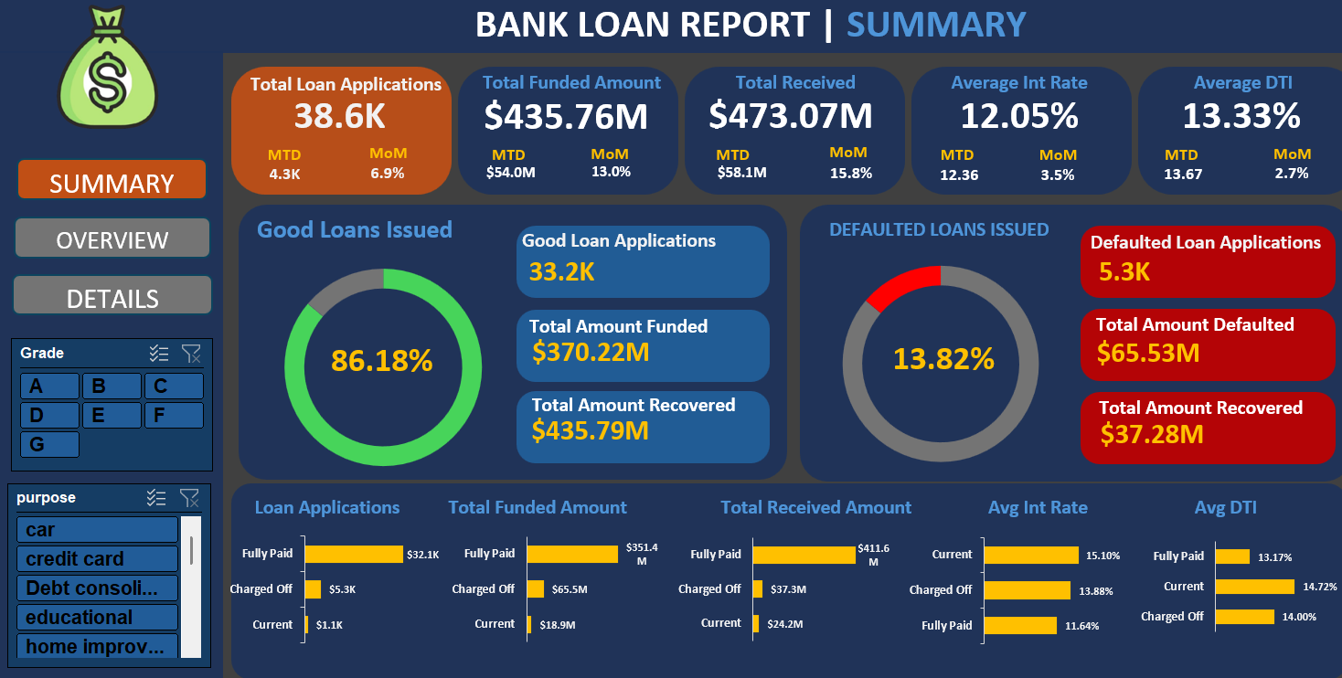
Visual Insights from Dashboards

Slide 19
Visual Insights from Dashboards (Continued)
Insights from Summary Dashboard
1. High Loan Success Rate
86.18% of all loans issued are Good Loans, indicating strong repayment behavior.
2. Default Level is Moderate but Significant
13.82% loans are in default, resulting in $65.53M total defaulted amount.
3. Good Loans Drive Most of the Revenue
Good loans recovered $435.79M, far higher than other segments.
4. Interest Rate Difference Explains Risk
Charged-off loans have higher interest rates (13.88%+) compared to Fully Paid (11.64%).
5. Loan Purpose & Grade Affect Risk Profile
Filters (Grade & Purpose) allow identifying high-risk segments like lower grades and Debt Consolidation loans.

Slide 20
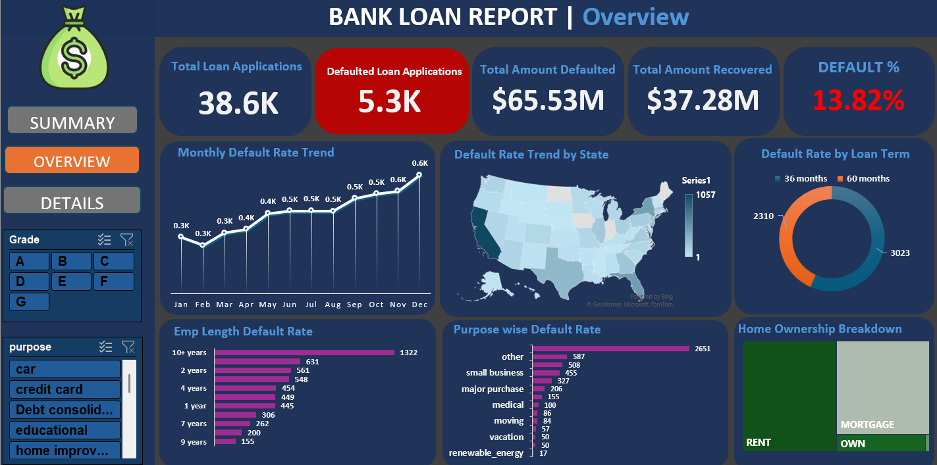
Visual Insights from Dashboards (Continued)

Slide 21
Visual Insights from Dashboards (Continued)
Insights from Overview Dashboard
1. Default Rate is Gradually Increasing
Monthly trend shows defaults rising from 0.3K in Jan to 0.6K in Dec → consistent upward risk pattern.
2. State-wise Defaults Vary Significantly
Some states show very high default concentration, while others remain low → geographic risk differences.
3. Longer Loan Terms Have Higher Default Rates
60-month loans default more than 36-month loans → longer commitments increase risk.
4. Certain Loan Purposes Are High Risk
Highest defaults come from Other, Small Business, and Debt Consolidation categories.
5. Employment Length Doesn't Guarantee Low Risk
Even borrowers with 10+ years experience show high defaults → stability doesn’t always mean safe borrowing.

Slide 22
Final Recommendations
Tighten loan approval rules for high-risk segments (low grades: E, F, G).
Increase interest rates or add stricter checks for borrowers with high DTI or high loan amounts.
Strengthen verification for high-risk loan purposes (Debt Consolidation, Small Business, Other)
Promote shorter loan terms (36-month) to reduce default probability.
Use automated alerts for risky profiles (high DTI, high interest rate, long loan term).

Slide 23
Conclusion
This project analyzed loan applications, borrower profiles, and repayment behavior using Python and Power BI.
Clear patterns emerged: higher DTI, higher interest rates, lower grades, and certain loan purposes increase default risk.
Insights help the business improve approval policies, identify high-risk customers, and reduce default losses.
Overall, the analysis supports smarter credit decisions and better portfolio risk management.

